Slide 1


Data Scraping and Visualisation with Python
Parth Verma | Anmol Sahni under the guidance of Dr. Santosh Kumar Singh

Slide 2
Overview
The "Data Scraping and Visualization with Python" extract valuable insights from hirist.com and present Insights to the user. This is done by scraping the website using libraries such as:
BeautifulSoup
Requests
producing insights using
Pandas
Numpy
plotly.

Slide 3
Overview
Through these techniques, the project does the following:
Takes user input (field or a skill)
Automates the retrieval of crucial information:
Company names
Position titles
Skills
Produces insights from retrieved data
Presents insights on the page
Locations
Experience requirements
Posting Dates

Slide 4

Use Case Diagram
Web Scraping Application
View Homepage
Process Data
Write to Csv
View
Scrape Data
Enter Field
Generate Insights
Field
Insights

Slide 5
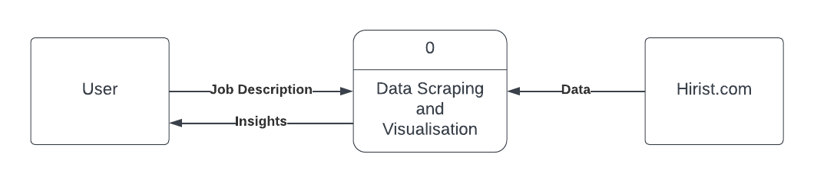
Data Flow Diagrams
0 LEVEL
Request

Slide 6
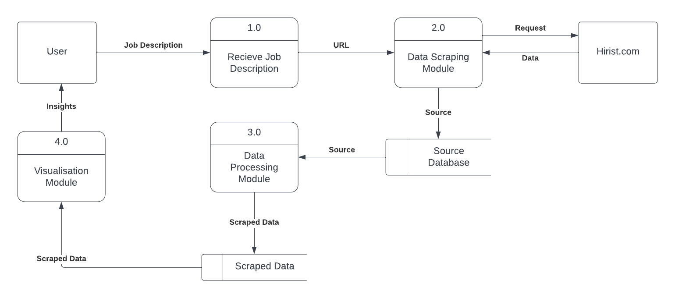
1 LEVEL
Receive Job Application
Data Scraping Module
Data Processing Module
Data Visualisation Module

Slide 7
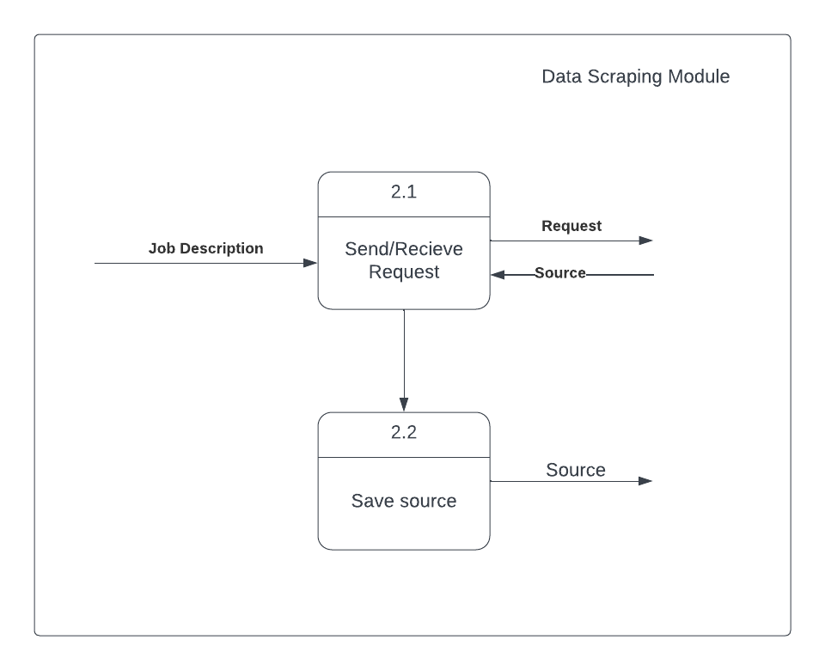
2 LEVEL
Data Scraping Module

Slide 8
1 LEVEL
Receive Job Application
Data Scraping Module
Data Processing Module
Data Visualisation Module

Slide 9
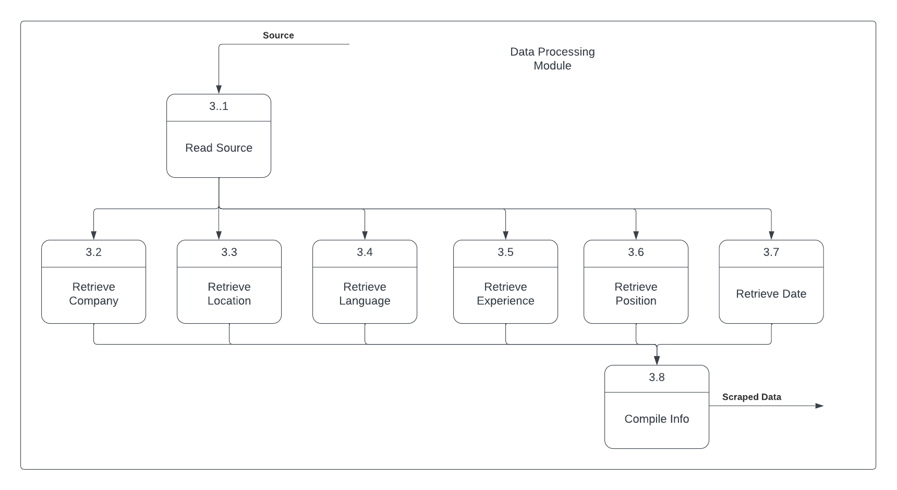
2 LEVEL
Data Processing Module

Slide 10
1 LEVEL
Receive Job Application
Data Scraping Module
Data Processing Module
Data Visualisation Module

Slide 11
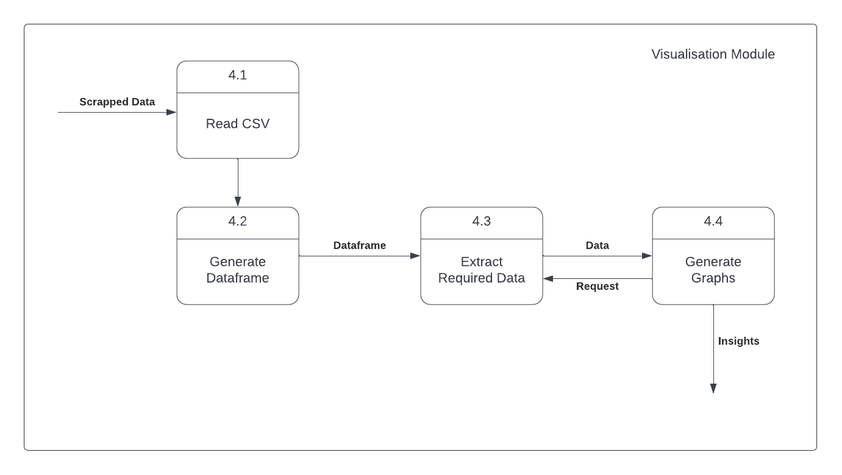
2 LEVEL
Data Visualisation Module

Slide 12
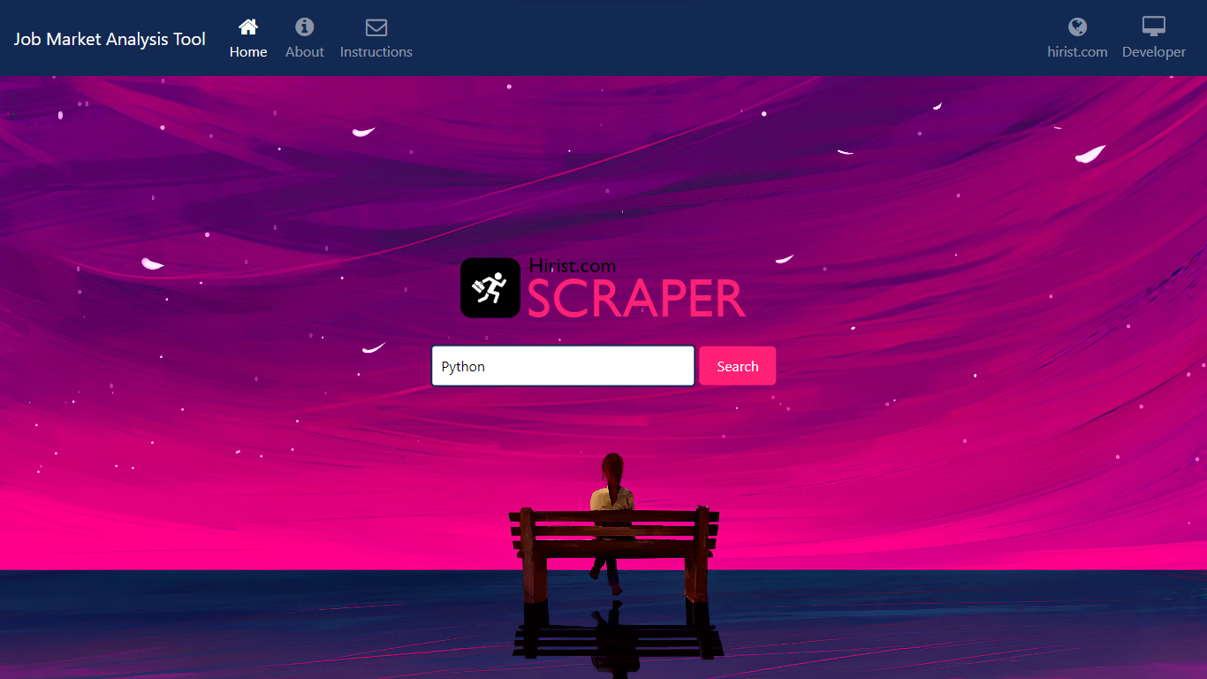
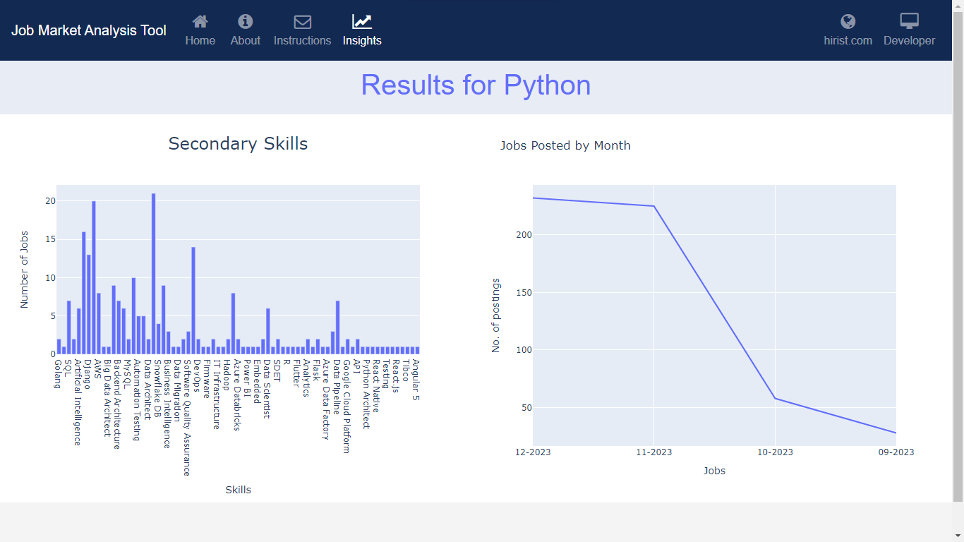
Screenshots

Slide 13
Screenshots

Slide 14
Future Scope
Data Accuracy and Relevance
Enhanced Data Sources
Advanced Analytics Features
Customisation and Personalisation
Mobile Application Development
Interactive Visualisation

Slide 15
THANK YOU

